Slide 1
An Anatomy of Inheritance
David Sackstein

Slide 2
Agenda
What do we mean by inheritance?
The Single Responsibility Principle
Two types of inheritance
Inheritance of contract
Inheritance of implementation
Benefits and costs
Prefer composition over inheritance
Summary and discussion

Slide 3
What is inheritance?
Inheritance is a powerful tool of the language which provides:
Polymorphism (either through an interface or an abstract class)
Code reuse where methods in the derived call methods in the base (common)
Code reuse where the base calls the derived (the Template Method)
Any combination of the above together
What about extension?
Extension is a combination
It involves polymorphism and code reuse where the derived calls the base.

Slide 4
The Single Responsibility Principle
Classes, functions, components should do only one thing
Similarly, type relationships should also describe only one thing:
One type is the caller and the other is the callee or vice versa. Not both.
One type is the client, the other is the server (or implementation).
One type is the interface, the other is the implementation
Relationships should therefore be:
Easy to reason about (a well-defined API, preferably an interface)
Unidirectional (no cycles). You have a cycle? Break it with another type.

Slide 5
Using inheritance..
Inheritance allows relationships to be cyclic
The base can call the derived and vice versa
The cycle can be long, extending through a long chain of inheritance relations
Even without cycles, relationships can span across distant classes
A type may
Represent the API of another
But also contain part of its implementation
When used freely:
The code is no longer located in one class and becomes difficult understand
The relationship between base and derived are not clear
Cyclic dependencies can only be tested together

Slide 6
Two types of inheritance
Inheritance of contract (polymorphism)
implement an interface
You could also extend a purely abstract class (but why would you?)
Oh, because you want to place implementations in the base?
That is a violation of the Single Responsibility Principle for relationships
Inheritance of implementation

Slide 7
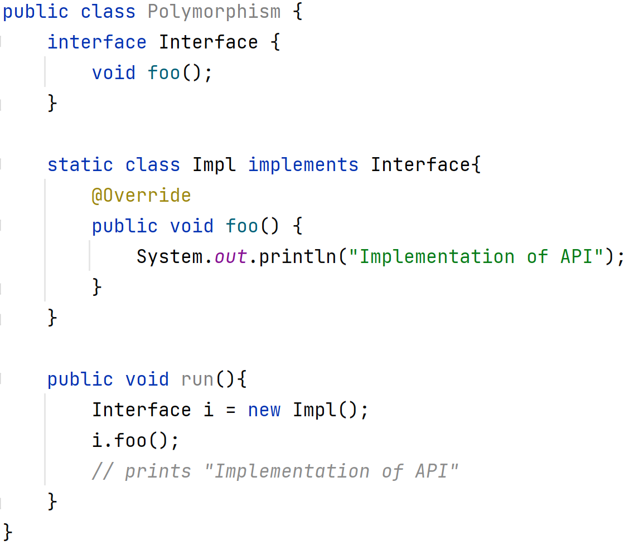

Slide 8
Inheritance of implementation
Derived class calls common code in base class (Simple code reuse)
extends a class and call method(s) of the base (using super.)
Common code in the base calls the derived (Template Method)
extends an abstract class and override method(s)
Called the Template Method design pattern

Slide 9
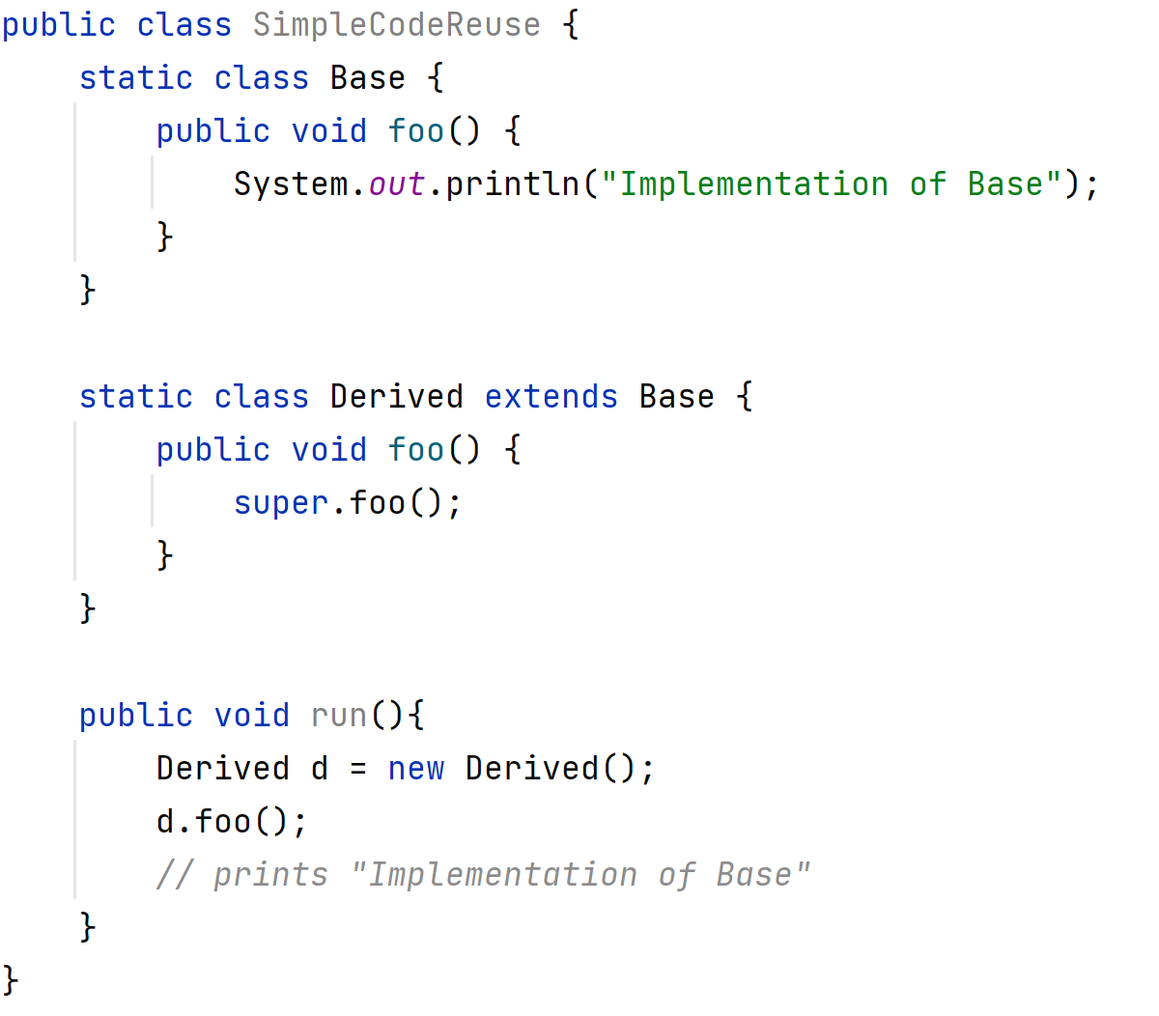
Derived class uses base

Slide 10
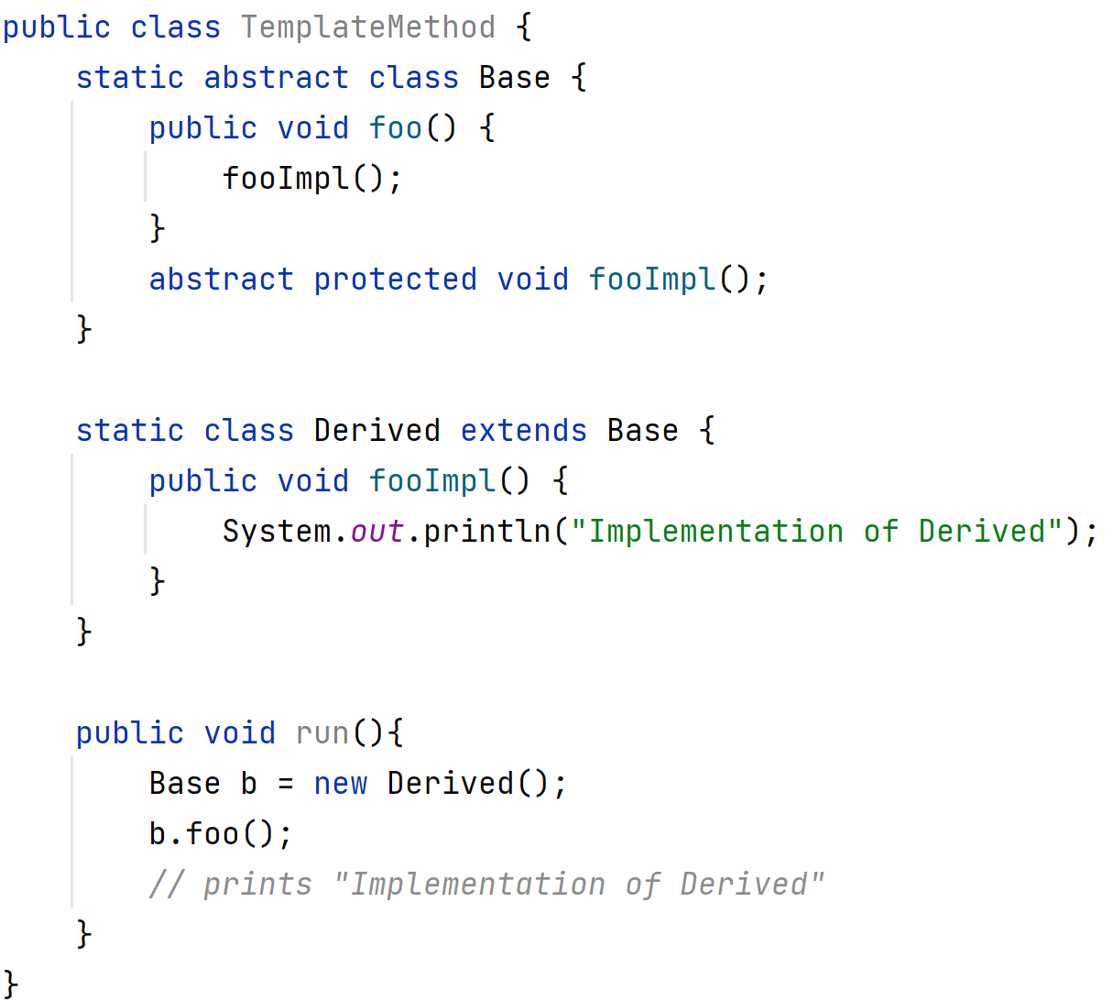
Base class uses derived class

Slide 11
Polymorphism: Benefits
Users of the interface cannot see the implementation
Users of the interface can clearly see the contract
This is the purest and most distilled example of encapsulation
Benefits of encapsulation:
Testability: Replacement of implementations using mocks.
Extensibility: Upgrading implementations without rebuilding the caller.

Slide 12
Polymorphism: Costs
Users of the interface cannot see the implementation
This may make it difficult to fully understand the code
But this should not come as a surprise because the assumption is:
That the caller code is easy to understand without seeing the implementation
This is a way of saying that caller and callee are decoupled
It’s a trade-off (is decoupling good or bad?)
There is such a thing as over abstraction
(Just like there is such a thing as doing too much sports)

Slide 13
Inheritance of Implementation: Benefits
Avoids code duplication by:
Moving common code into the base class
Moves varying code into derived classes
You can call the implementation without specifying the name of an object
But that’s it. It has:
No benefit for testability
No benefit for extensibility
No benefit for readability

Slide 14
Inheritance of Implementation: Costs
It introduces coupling between the derived class and the base class:
Base class behavior can be overridden arbitrarily by any derived class.
(By default, in Java all methods are virtual)
These changes can break the base class
These changes can break the derived class (like the example in the video).
It limits reuse of the derived class. (because it can only be reused if the implementation provided in the base class is desired too).

Slide 15
Inheritance of Implementation: Benefits
It breaks encapsulation Because it provides the caller with access to all public members of the implementation class. It’s like marking your implementation fields and methods public.
It limits testability of the derived class Because the implementation in the base class cannot be replaced by a mock in a test
It allows cyclic dependencies Because the base class can call the derived class and vice versa

Slide 16
Summary so far
Inheritance of Contract (polymorphism) Good
Inheritance of Implementation (code reuse) Bad
It would seem that we should never use the keyword extends
Exception: You can use extends between data classes because:
We don’t test data classes
There are no methods in data classes, so no cycles
Data class expose all their data as public. No need for encapsulation

Slide 17
Prefer Composition over Inheritance
Composition should be used to implement code reuse
Everywhere you use inheritance today you can use composition.

Slide 18

Base class becomes a member

Slide 19
Derived class becomes a member

Slide 20
Summary
Create simple relations between types
A relationship is either user/used or contract/implements
The relationship should be unidirectional (no cycles)
Prefer composition over inheritance
The composed type should have a clear API, preferably an interface
Use interfaces if decoupling is needed. Don’t worry about over-abstraction
Use extends for data types but not for classes
Surprising, no?

Slide 21
Discussion

